Slide 1
Plan

Slide 2
Session A overview

Slide 3



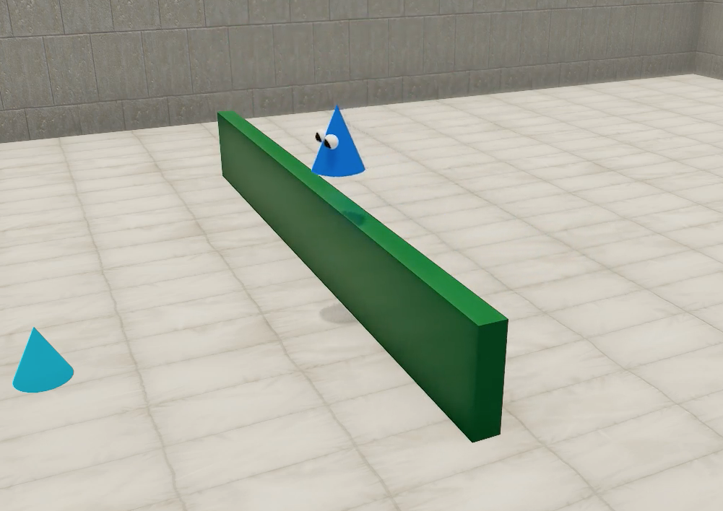




Repeats
attention getter
OR
45 seconds
ONE TRIAL
* you can pause (press “p”) or stop (press esc-key) the study at any point.
Total: 8 trials
(+ 4 optional trials)
= 7 - 10 minutes *
Notes:
Here’s a brief overview of what will happen during the study. [CLICK]
At the beginning of every trial, your child will see an exciting stimulus, like a rotating or pulsing star, which we call the ‘attention-getter’, because we use it to get your child’s attention. [CLICK]
Then, we will show a video of an animated creature reach another object, like you see here. This video will repeat for about 45 seconds. [CLICK]
These two videos, the attention getter and the video of the animated creature, together form one trial. We’ll have a total of eight trials. We’ll ask you after that whether you and your child are up for another four trials, depending on how you two are feeling. [CLICK]
In either case, the experiment should take somewhere between 7 and 10 minutes. [CLICK]
Of course you can pause by pressing the “p” key on your keyboard or stop the experiment by pressing the escape key at any time.

Slide 4
Session B overview

Slide 5
Repeats
attention getter
OR
until your child looks away for three seconds
in a row (max. 45 sec)
ONE TRIAL
* you can pause (press “p”) or stop (press esc-key) the study at any point.
Total: about 10-14 trials
(+ 2 optional trials)
= 7 - 10 minutes *
Notes:
Here’s a brief overview of what will happen during the study. [CLICK]
At the beginning of every trial, your child will see an exciting rotating or pulsing star, which we call the ‘attention-getter’, because we use it to get your child’s attention. [CLICK]
Then, we will show a video of an animated creature reaching another object, like you see here. This video will repeat until your child looks away for three seconds in a row, and we’ll give you more instructions in just a bit on how to indicate when your child has looked away. If your child hasn’t looked away for 3 seconds during the entire 45 second trial, the video will end automatically. [CLICK]
These two videos, the attention getter and the video of the animated creature, together form one trial.
We’ll have a total of about 10-14 trials. We’ll ask you after that whether you and your child are up for another two trials, depending on how you two are feeling. [CLICK]
In either case, the experiment should take somewhere between 7 and 10 minutes. [CLICK]
Of course you can pause by pressing the “p” key on your keyboard or stop the experiment by pressing the escape key at any time.

Slide 6
Lookit replication

Slide 7

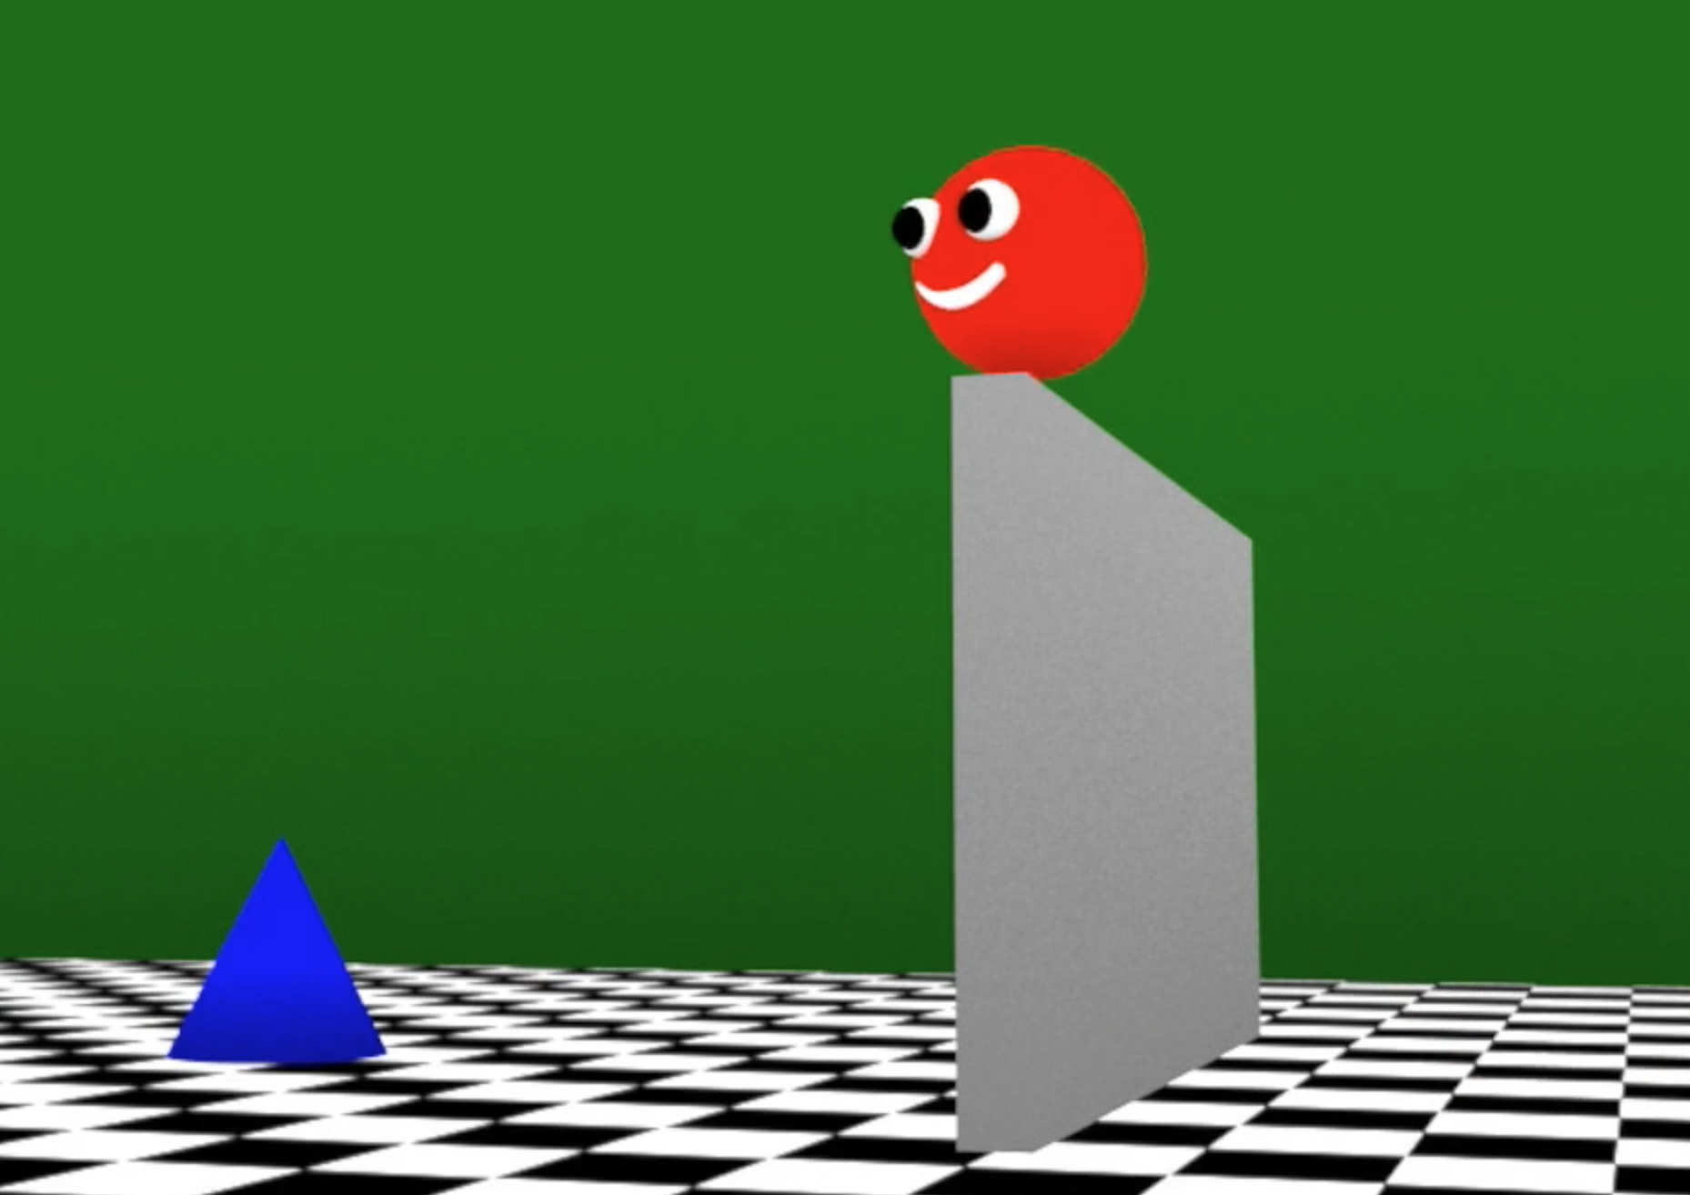

Repeats
attention getter
until your child looks away for three seconds
in a row (max. 60 sec)
ONE TRIAL
* you can pause (press “p”) or stop (press esc-key) the study at any point.
Total: 10 trials
= 5 - 7 minutes *
Notes:
Here’s a brief overview of what will happen during the study. [CLICK]
At the beginning of every trial, your child will see an exciting pulsating star, which we call the ‘attention-getter’, because we use it to get your child’s attention. [CLICK]
Then, we will show a video of an animated creature reaching another object, like you see here. This video will repeat until your child looks away for three seconds in a row, and we’ll give you more instructions in just a bit on how to indicate when your child has looked away. If your child hasn’t looked away for 3 seconds during the entire 60 second trial, the video will end automatically. [CLICK]
These two videos, the attention getter and the video of the animated creature, together form one trial.
We’ll have a total of 10 trials. [CLICK] and the experiment should take somewhere between 5 and 7 minutes. [CLICK]
Of course you can pause by pressing the “p” letter key on your keyboard or stop the experiment by pressing the escape key at any time.

Slide 8
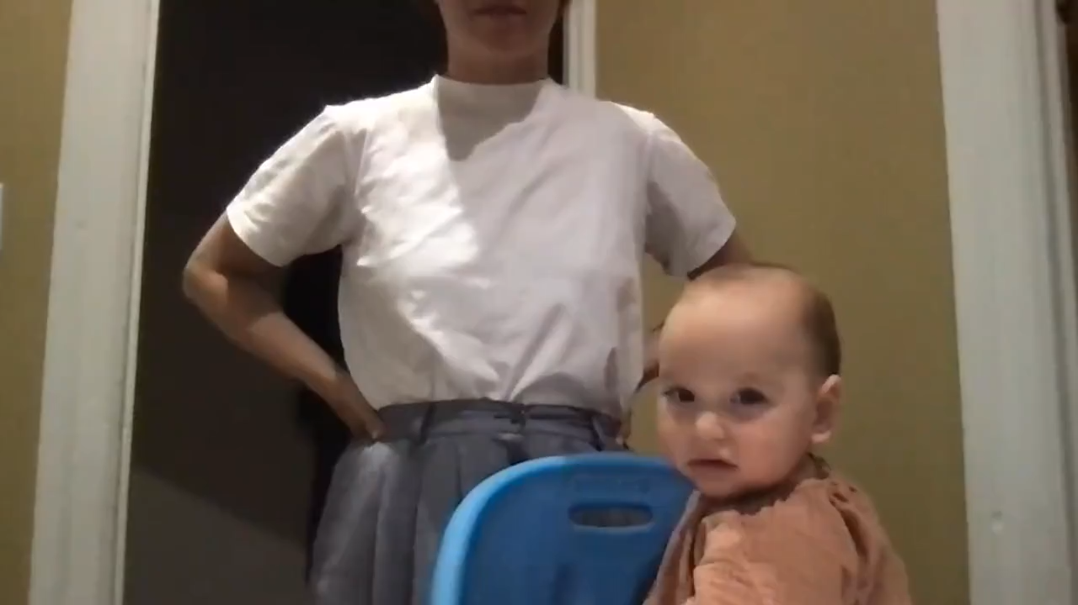
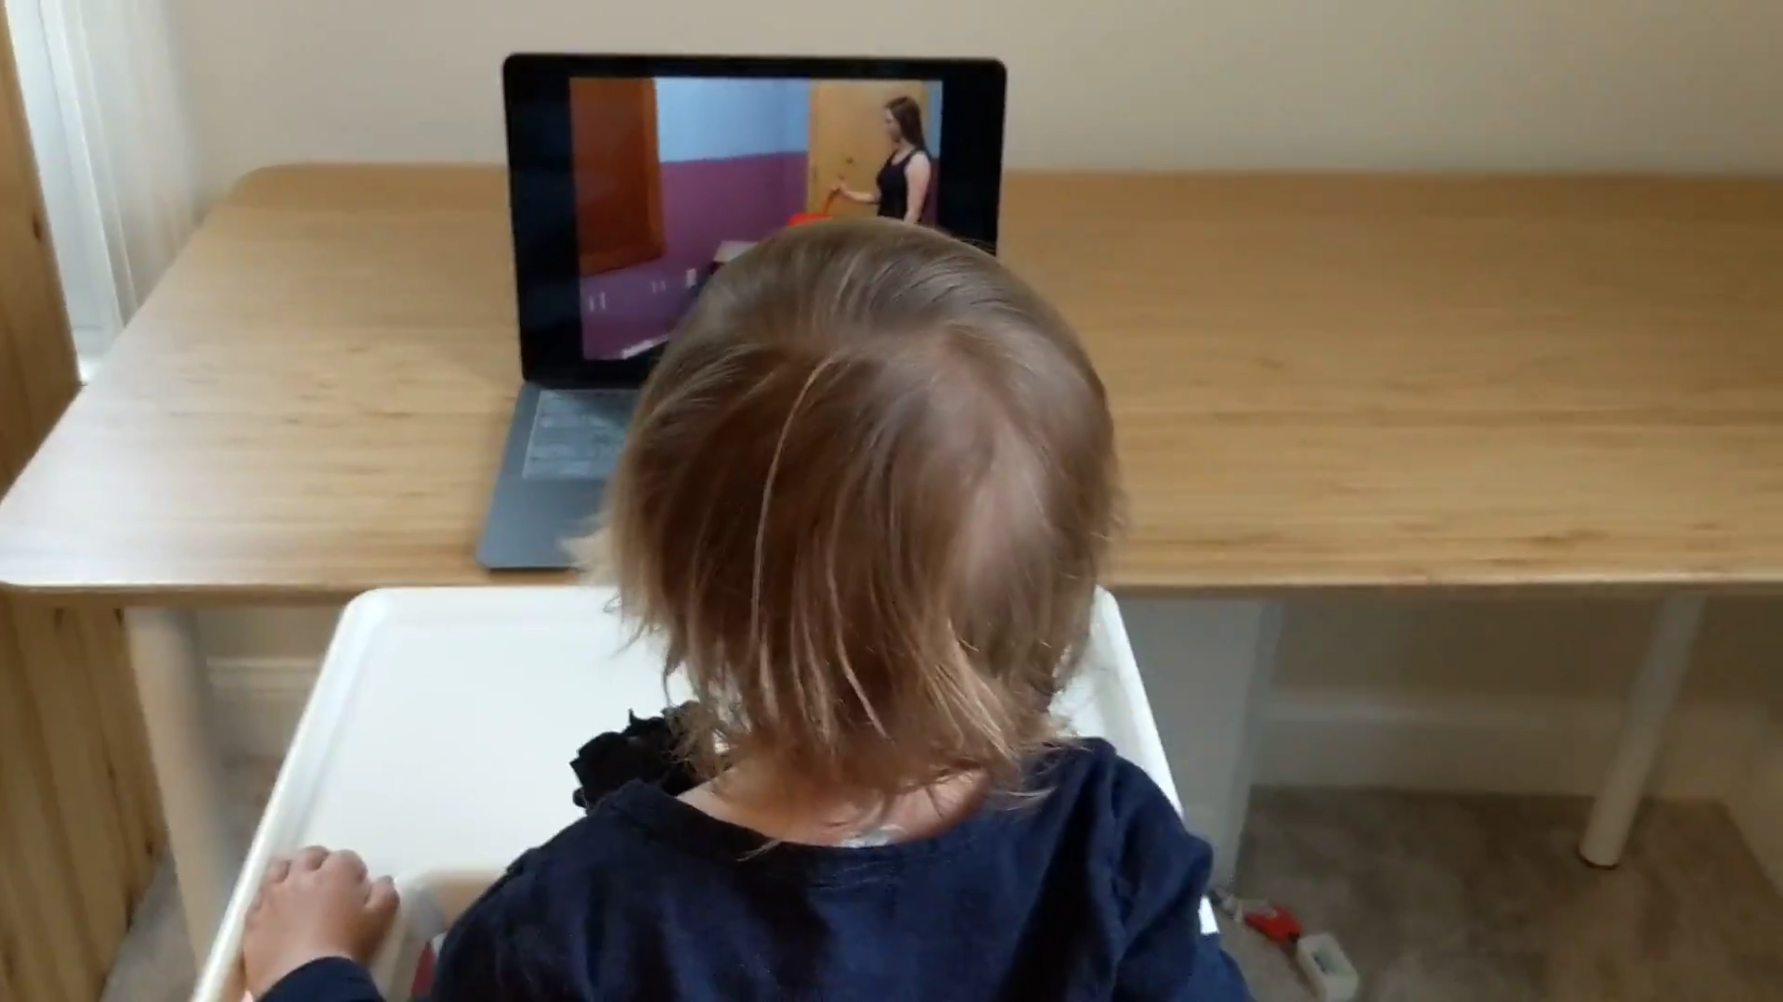
Parent control instructions
Notes:
Ask shari about if she counts up LT until crierion or take

Slide 9







Compare to
Classic method
Block method
Fam
exp
surp
parent-controlled habituation
optional
COMPARE
10s
X 5
10s
X 5
10s
X 5
10s
X 5
Scene 1
Scene 2
Scene 3
Scene 4
10s
X 5
10s
X 5
optional
Scene 1
Scene 2
Notes:
Scenarios: cliff jump, cliff test on bridge, barrier jump, barrier go around
Reach out to shari about instructions for parents - ( )
Select one of four scene orders:
1,2,3,4
4,3,2,1
2,4,1,3
3,1,4,2

Slide 10
Compare to
Classic method
Block method
Fam
exp
surp
parent-controlled habituation
optional
COMPARE
10s
X 5
10s
X 5
10s
X 5
10s
X 5
Scene 1
Scene 2
Scene 3
Scene 4
10s
X 5
10s
X 5
optional
Scene 1
Scene 2
Notes:
Scenarios: cliff jump, cliff test on bridge, barrier jump, barrier go around
Reach out to shari about instructions for parents - ( )
Select one of four scene orders:
1,2,3,4
4,3,2,1
2,4,1,3
3,1,4,2

Slide 11
Compare to
Classic method
Fam
exp
surp
parent-controlled habituation
Notes:
Scenarios: cliff jump, cliff test on bridge, barrier jump, barrier go around
Reach out to shari about instructions for parents - ( )
Select one of four scene orders:
1,2,3,4
4,3,2,1
2,4,1,3
3,1,4,2

Slide 12
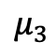
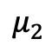
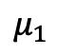
Compare to
Classic method
Fam
exp
surp
parent-controlled habituation
$$μ_{1}$$
$$μ_{2}$$
Max.60s
$$μ_{3}$$
Notes:
Scenarios: cliff jump, cliff test on bridge, barrier jump, barrier go around
Reach out to shari about instructions for parents - ( )
Select one of four scene orders:
1,2,3,4
4,3,2,1
2,4,1,3
3,1,4,2

Slide 13
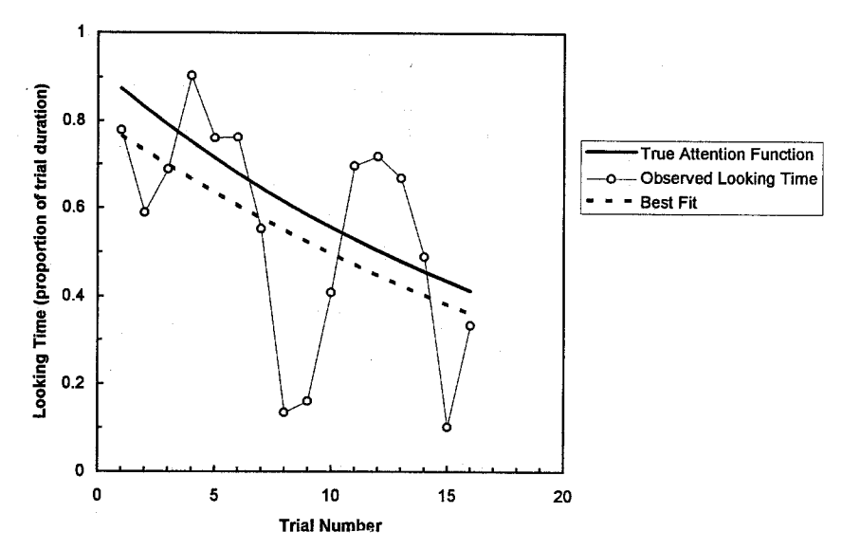
Compare to
Classic method
Fam
exp
surp
parent-controlled habituation
“Measuring Habituation in Infants: An Approach Using Regression Analysis”
Ashmead & Davis, 1996
Notes:
Scenarios: cliff jump, cliff test on bridge, barrier jump, barrier go around
Reach out to shari about instructions for parents - ( )
Select one of four scene orders:
1,2,3,4
4,3,2,1
2,4,1,3
3,1,4,2

Slide 14
Compare to
Classic method
Fam
exp
surp
parent-controlled habituation
How to pre-register analysis of non-habituated kids? (Oakes: exclude) – Decision: report how many kids didn’t habituate, do ‘multiverse’: when comparing effect sizes between block & classic: check what happens when we exclude non-habituated kids and include everbody
Notes:
Scenarios: cliff jump, cliff test on bridge, barrier jump, barrier go around
Reach out to shari about instructions for parents - ( )
Select one of four scene orders:
1,2,3,4
4,3,2,1
2,4,1,3
3,1,4,2

Slide 15
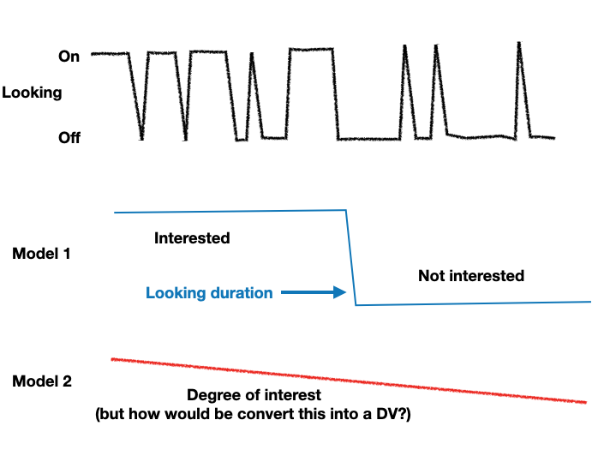
1. Does infant looking generally follow Model 1 or 2?
Notes:
Are the relative contributions predictive of other things.
There are multiple components to looking – maybe model 1 and model 2 capture different aspects of looking:
e.g. surprise is more captured by look duration, general interest is more captured my degree of interest/attentiveness

Slide 16
2. Are there individual differences in relative contributions of Model 1 vs 2?
”encoding” ?
Practical note: If we pursue this, will need to run non-infant controlled experiments?
”failure to disengage” ?
Notes:
There are multiple components to looking – maybe model 1 and model 2 capture different aspects of looking:
e.g. surprise is more captured by look duration, general interest is more captured my degree of interest/attentiveness
Is there no way to figure out whether the latent variable generating binary data is continuous or thresholded?
Separate question: is the looking that happened until lookaway criterion predictive of what happened after the criterion was reached? Can check this in 60 sec test trial from MCS ?

Slide 17
Pokebaby thought
From our last discussion: “babies don’t really compute EIG, we are just doing a rational analysis”
Rational analysis: “explain the function and purpose of cognitive processes”
e.g. “babies act rationally if what they’re trying to do is maximize EIG about a concept”.
What throws me off: Once we introduce computational limitations - in our case it’s noisy sampling, we might be mistaking rational behavior given noisy sampling for irrational behavior.
In other words: our noise parameter might absorb deviations from EIG maximization.
Notes:
Rational analysis: “explain the function and purpose of cognitive processes”

Slide 18
Thoughts about lab github/repository
Thinking about processes to make shelved or ”failed” projects available to lab members.
Common lab doc with past + present projects with links to project files, and some internal or public write-up of what happened, especially if it wasn’t published.

